Slide 1
Modelling Patient Flow
MDM3 Project 2019
Chris McWilliams
University Hospitals NHS Foundation Trust

Slide 2
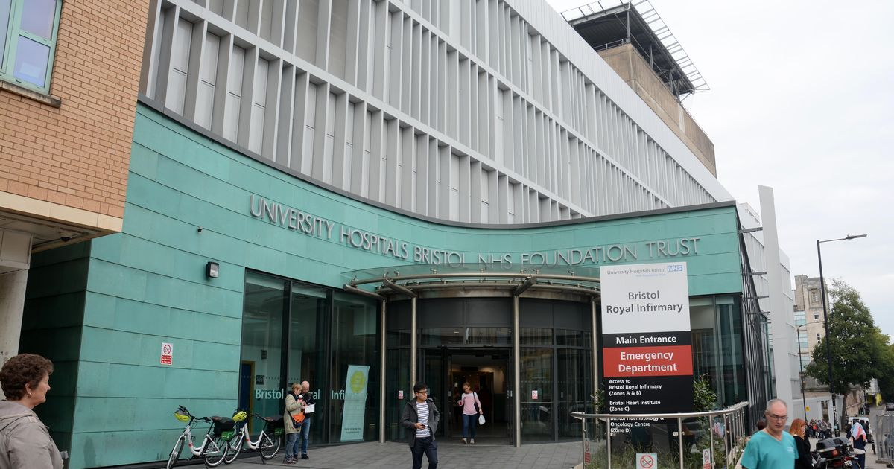

Slide 3
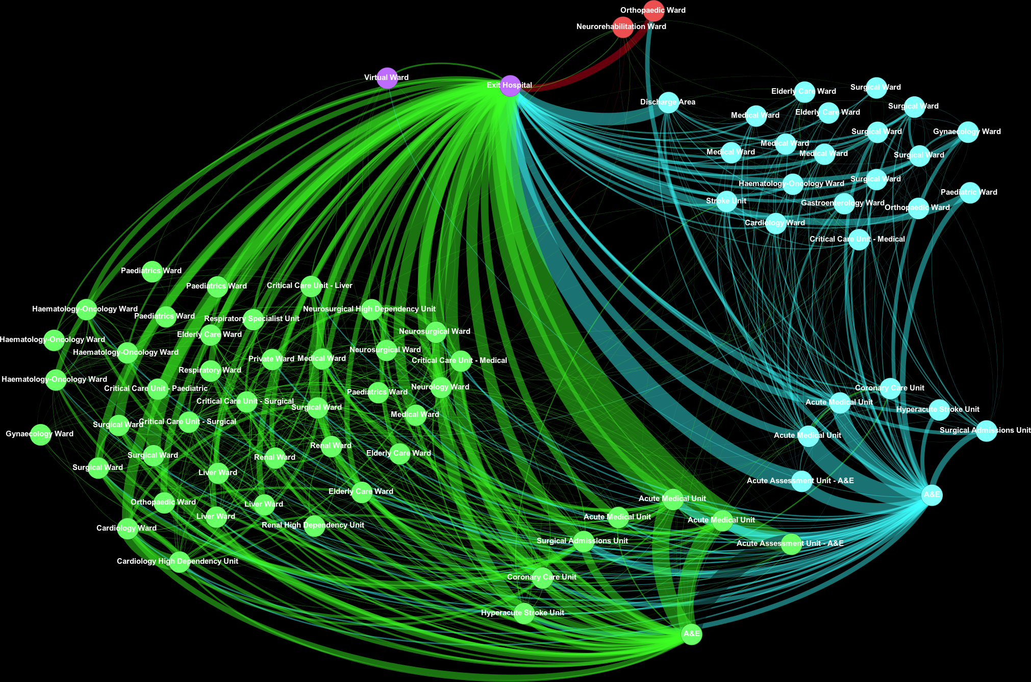
Daniel M. Bean , Clive Stringer, Neeraj Beeknoo, James Teo , Richard J. B. Dobson

Slide 4
Daniel M. Bean , Clive Stringer, Neeraj Beeknoo, James Teo , Richard J. B. Dobson
“Network analysis of patient flow in two UK acute care hospitals identifies key sub-networks for A&E performance” [1]

Slide 5
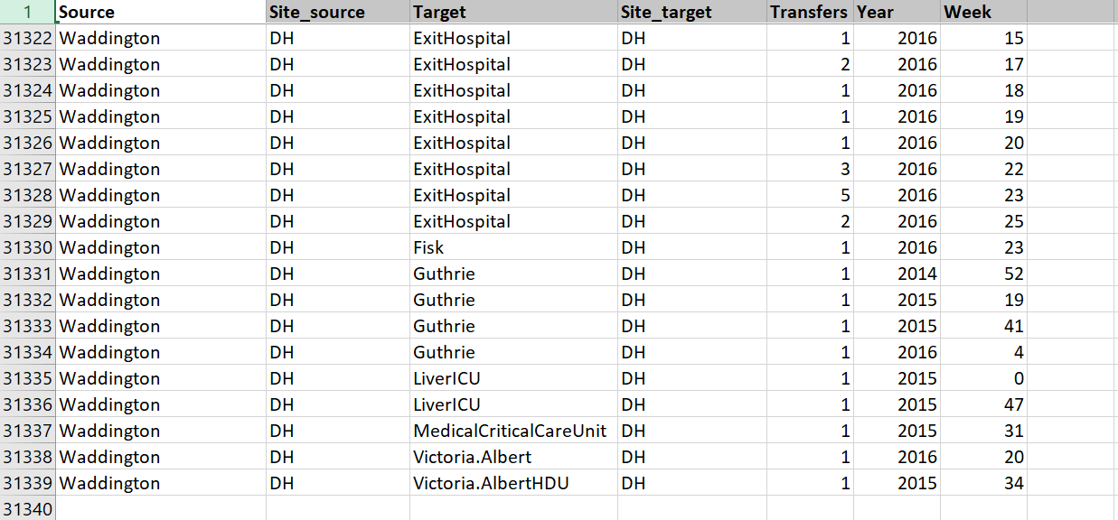
The data…
18 months – all intra-hospital transfer across two sites.

Slide 6

The challenge…
Model patient flow across the hospital network.
Suggested approach:
Brief literature review.
Extract the network structure (and study it).
Define and parameterise model.
Simulate and analyse results.

Slide 7
References
Bean DM, Stringer C, Beeknoo N, Teo J, Dobson RJ. Network analysis of patient flow in two UK acute care hospitals identifies key sub-networks for A&E performance. PloS one. 2017 Oct 2;12(10):e0185912.
Kohler K, Ercole A. Characterising complex healthcare systems using network science: The small world of emergency surgery. arXiv preprint arXiv:1908.01688. 2019 Aug 5.

